Slide 1
Data Link Layer

Slide 2
Responsibilities of DLL
Provide following services to upper layer protocols:
Logical Link Control Sublayer
Framing
Error Control
Flow Control
Reliable Transmission
In multipoint network, MAC sublayer will be present after LLC at DLL.
Medium Access Control

Slide 3
Network Performance Matrix
Network performance can be measured in two different ways:
Latency
Bandwidth (Throughput)
Defn: Network throughput (or effective throughput) is the measured number of bits that can be transmitted over a particular medium in a given amount of time. Usually, described in bits/sec (or bps).
The throughput is the maximum number of bits/sec an application can expect to receive.
Bandwidth >= Throughput
For applications, we can describe throughput as the “bandwidth requirements of an application.”

Slide 4
Network Performance Matrix
Defn: Latency (or end-to-end delay) is the amount of time is takes for a single bit to propagate from one end of a network to another. It depends upon the following factors:
Propagation delay
Transmission time
Queueing delay
Processing delays

Slide 5
Network Performance Matrix
Propagation delay
We calculate this using the speed-of-light propagation delay:
in a vacuum, 3.0 * 10⁸ meters/sec
in a cable, 2.3 *10⁸ meters/sec
in fiber, 2.0 * 10⁸ meters/sec
This value is a function of the distances and the speed-of-light delay.
Transmission Delay
This is the amount of time it takes to transmit the data onto the transmission media. This value is a function of the bandwidth and the packet size.
Queueing Delay
This is the time the data spends in being waiting for its turn (queueing) to be transmitted.
4. Processing Delay
This is the time the data spends in being processed to be transmitted.

Slide 6

Latency
$$Latency \left(L\right)=T_{prop}+T_{trans}+T_{queu}+T_{proc}$$

Slide 7
Example
Given the internet pictured below with a propagation speed of 200 m/microsec on the packet-switched WAN and the LAN and:
nodes 1-4 equidistantly spaced 2 km apart on a WAN with 50 Mbps links between nodes.
Assume processing time for these nodes is 0.
nodes A, B, Y, Z and 4 are on a 10BASE5 coaxial LAN with nodes A and Z at the absolute
edge of the LAN segment and node 4 connected at the middle of the LAN.
Assume a packet = frame = 1000 bytes on this internet, and no processing delay at any nodes.
How long will it take to send a packet from node 1 to node Z in the situation that when the packet arrives at node 4 there are two packets in front of it waiting to go out on the LAN to Node A.

Slide 8
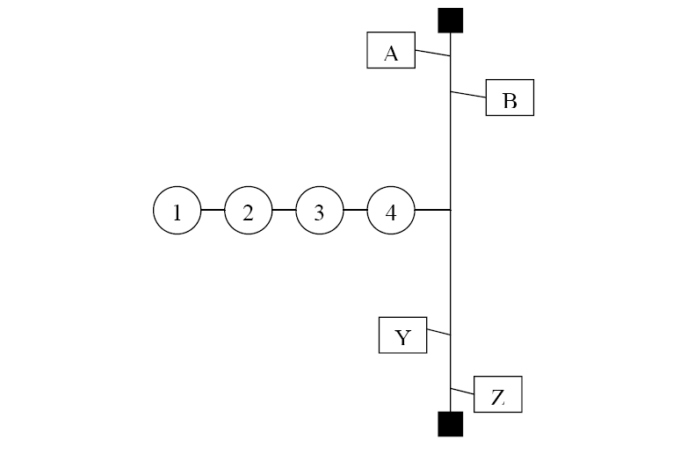
Example

Slide 9
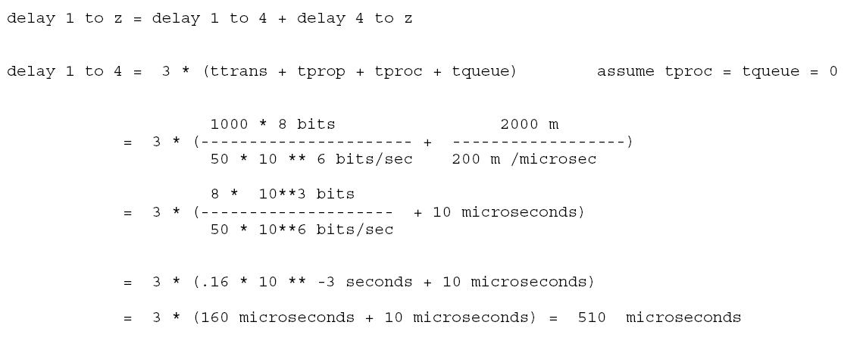
Solution

Slide 10
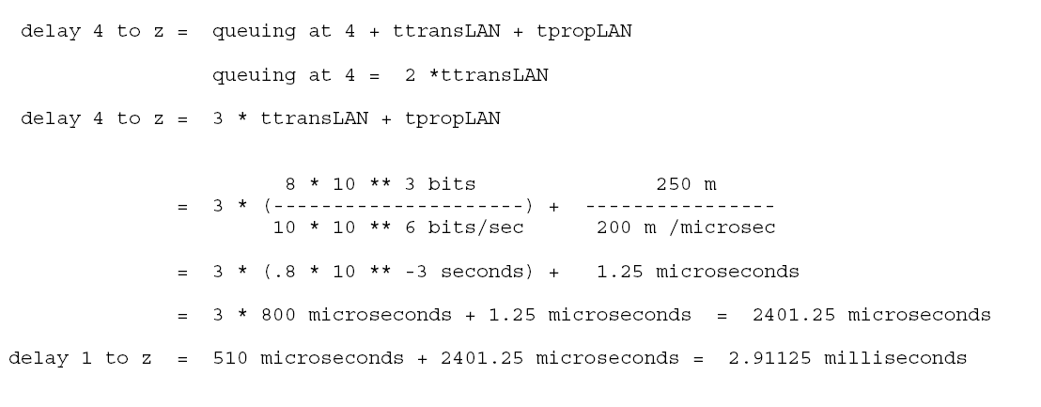
Solution

Slide 11
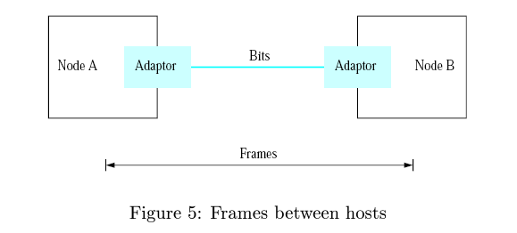
Framing Protocols
In computer networks, we are operating in a packet switching network which means block of data (not individual bits) are exchanged between the nodes.
Network adapter enables the nodes to exchange frames (block of data).
The problem at the DLL is that how to mark the start of the frame and end of the frame in the bit stream received from the physical later.

Slide 12
Framing Protocols
Several approached are used to handle this problem:
Framing Protocols
Byte Oriented Approach
Bit Oriented Approach
Sentinel Approach
Sentinel Approach
Byte Counting Approach

Slide 13
Framing Protocols (Contd.)
Byte-oriented Protocols
To view each frame as a collection of bytes (characters) rather than bits.
Sentinel Approach
BISYNC (Binary Synchronous Communication) Protocol
Developed by IBM (late 1960)
Byte Counting Approach
DDCMP (Digital Data Communication Protocol)
Used in DECNet

Slide 14

Framing Protocols (Contd.)
BISYNC – Sentinel Approach (Byte Oriented)
Frames transmitted beginning with leftmost field
Beginning of a frame is denoted by sending a special SYN (synchronize) character
Data portion of the frame is contained between special sentinel character STX (start of text) and ETX (end of text)
SOH : Start of Header
DLE : Data Link Escape
CRC: Cyclic Redundancy Check
BISYNC Frame Format

Slide 15

Framing Protocols (Contd.)
DDCMP: Byte-counting approach (Byte Oriented)
count : how many bytes are contained in the frame body
If count is corrupted
Framing error
DDCMP Frame Format

Slide 16

Framing Protocols (Contd.)
Point to Point Protocol (PPP): Sentinel Approach (Bit Oriented)
which is commonly run over Internet links uses sentinel approach
Special start of text character denoted as Flag
0 1 1 1 1 1 1 0
Address, control: default numbers
Protocol for demux: IP / IPX
Payload : negotiated (1500 bytes)
Checksum: for error detection
Specifies what kind of packet is contained in the payload, e.g., LCP, NCP, IP, OSI CLNP, IPX
PPP Frame Format

Slide 17
HDLC header fields details (Byte Oriented)
Flag 01111110 | Address 11111111 | Control 00000011 | Data | CRC | Flag 01111110
All stations are to
accept the frame
Unnumbered frame
Difference between HDLC and PPP is that HDLC is implemented by Point-to-point configuration and also multi-point configurations on the other hand While PPP is implemented by Point-to-Point configuration only.

Slide 18
Framing Protocols (Contd.)
Problem with the framing protocols: If the special character appears in between the frame in Byte Oriented Approach.
Solution: Byte Stuffing.
Problem with the framing protocols: If the special bit sequence appears in between the frame in Bit Oriented Approach.
Solution: Bit Stuffing.

Slide 19
Byte Stuffing
Also referred to as character stuffing.
ASCII characters are used as framing delimiters (e.g. DLE STX and DLE ETX)
The problem occurs when these character patterns occur within the “transparent” data.
Solution: sender stuffs an extra DLE into the data stream just before each occurrence of an “accidental” DLE in the data stream.
The data link layer on the receiving end unstuffs the DLE before giving the data to the network layer.

Slide 20
Byte Stuffing (Example)
DLE
STX
Transparent Data
DLE
ETX
Before
DLE
STX
A
B
DLE
H
W
DLE
ETX
Stuffed
DLE
STX
A
B
DLE
DLE
H
W
DLE
ETX
Unstuffed
DLE
STX
A
B
DLE
H
W
DLE
ETX

Slide 21
Bit Stuffing
Each frame begins and ends with a special bit pattern called a flag byte [01111110]. {Note this is 7E in hex}
Whenever sender data link layer encounters five consecutive ones in the data stream, it automatically stuffs a 0 bit into the outgoing stream.
When the receiver sees five consecutive incoming ones followed by a 0 bit, it automatically destuffs the 0 bit before sending the data to the network layer.

Slide 22
Bit Stuffing (Example)
Input Stream
0110111111100111110111111111100000
Stuffed Stream
01101111101100111110011111011111000000
Stuffed bits
Unstuffed Stream
0110111111100111110111111111100000

Slide 23
Error Control
It is possible that data may get corrupted during the transmission because of noise, interference etc. This is known as error in the communication.
It is the responsibility of DLL and other higher layer to ensure error free communication.

Slide 24
Error Control (Contd.)
Error in the communication can be classified as:
Single Bit Error
Burst Error
Burst Error of 6 bits.
0 1 1 0 1 0 1 0
0 1 0 0 1 0 1 0
0 1 1 0 1 0 1 0
0 1 0 0 1 0 1 1

Slide 25
Error Control (Contd.)
Error Control at DLL
Error Detection Techniques
Error Correction Techniques
Hamming Codes
Parity Check
Checksum
CRC
Hamming Codes

Slide 26
Error Control (Contd.)
Basic Idea of Error Detection
To add redundant information to a frame that can be used to determine if errors have been introduced.
In general, we can provide strong error detection technique
k redundant bits, n bits message, k << n
In Ethernet, a frame carrying up to 12,000 bits of data requires only 32-bit CRC.
Parameter of evaluation
Total number of redundant bits requird.
Power of error detection / correction.

Slide 27
Error Control (Contd.)
Extra bits are redundant
They add no new information to the message
Derived from the original message using some algorithm
Both the sender and receiver know the algorithm
Sender Receiver
Receiver computes r using m bits. If they match, no error else data received has error.
m
r
m
r

Slide 28
Parity Check (One dimensional parity)
Algo:
Divide the message into words (7 bit word, 15 bit word, 31 bit word etc.)
Append a single parity bit at the end to the sequence of message bits.
Odd Parity: The parity bit is chosen to make the total number of 1’s in the message odd.
Even Parity: The parity bit is chosen to make the total number of 1’s in the message even.
Example of even parity: Green bit is the parity bit
Number of redundant bit required is very high.
Power of error detection: Can detect if odd number of bits are involved in the error.
0 1 1 0 1 0 1 0
0 1 0 0 1 0 1 0

Slide 29
Two-dimensional parity check
Two-dimensional parity is exactly what the name suggests
Two-dimensional parity does a similar calculation for each bit position across each of the bytes contained in the frame
This results in an extra parity byte for the entire frame, in addition to a parity bit for each byte.

Slide 30
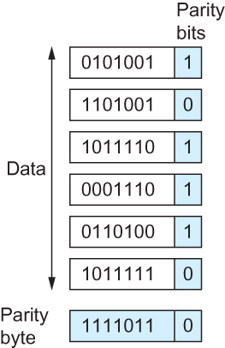
Two-dimensional parity check
Two Dimensional Parity
Number of redundant bits required is very high.
Two-dimensional parity catches all 1-, 2-, and 3-bit errors and most 4-bit errors.

Slide 31
Checksum
Transmitter’s Algo:
1’s complement arithmetic is used for implementation.
Divide the message into words. (8 / 16 / 32 bit words).
Calculate the sum of all the units using 1’s complement arithmetic.
Take ones complement of the result. This is called the checksum.
Transmit the checksum along with the message.
Receiver’s Algo:
Divide the message into words including the checksum. (8 / 16 / 32 bit words).
Calculate the sum of all the units using 1’s complement arithmetic.
Take ones complement of the result.
If the result is all zero then accept else discard.

Slide 32
1’s Complement Arithmetic
In ones complement arithmetic, a negative integer −x is represented as the complement of x;
Each bit of x is inverted.
When adding numbers in ones complement arithmetic, a carryout from the most significant bit needs to be added to the result.

Slide 33
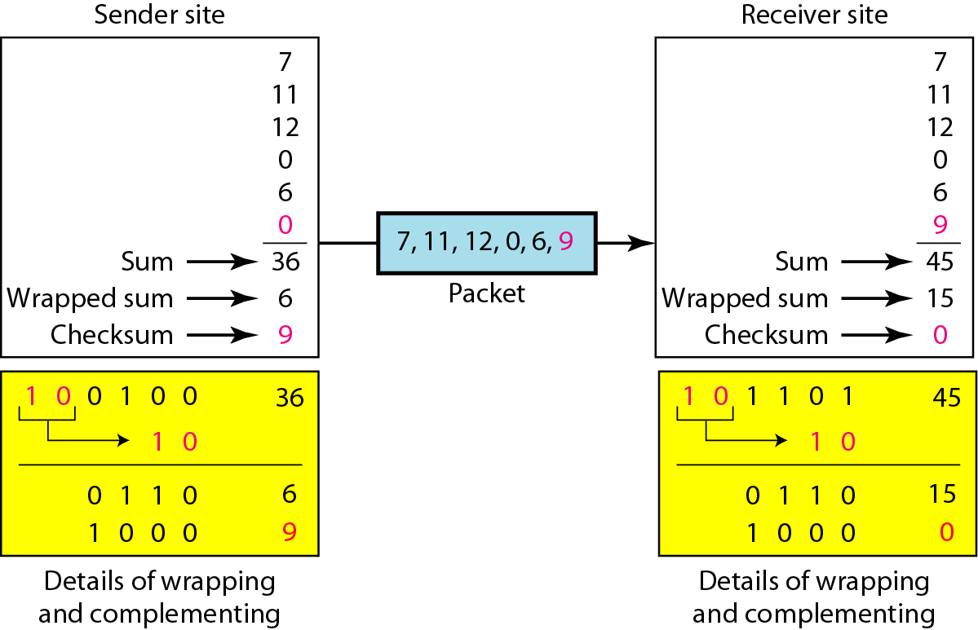
Example of decimal representation

Slide 34
Checksum Example
Consider, for example, the addition of −5 and −3 in ones complement arithmetic on 4-bit integers
+5 is 0101, so −5 is 1010; +3 is 0011, so −3 is 1100
If we add 1010 and 1100 ignoring the carry, we get 0110.
In ones complement arithmetic, the fact that this operation caused a carry from the most significant bit causes us to increment the result, giving 0111, which is the ones complement representation of −8 (obtained by inverting the bits in 1000), as we would expect.
At receiver’s end If we add 1010, 1100 and 1000 we get 1111 as sum.
Complement of 1111 is 0000. Which means there is no error in the transmission.

Slide 35
Checksum Example
0001
f203
f4f5
f6f7
+ 220d
------
2fffd
fffd
+ 2
------
ffff
0000
0001
f203
f4f5
f6f7
+(0000)
------
2ddf0
ddf0
+ 2
------
ddf2
220d
Sender’s Side Receiver’s Side

Slide 36
Checksum Properties
Number of redundant bits are constant and will depends on the word size chosen.
It can detect all the errors where odd number of bits are involved in the error, most of the 2-bits and most of the 4-bits errors.

Slide 37
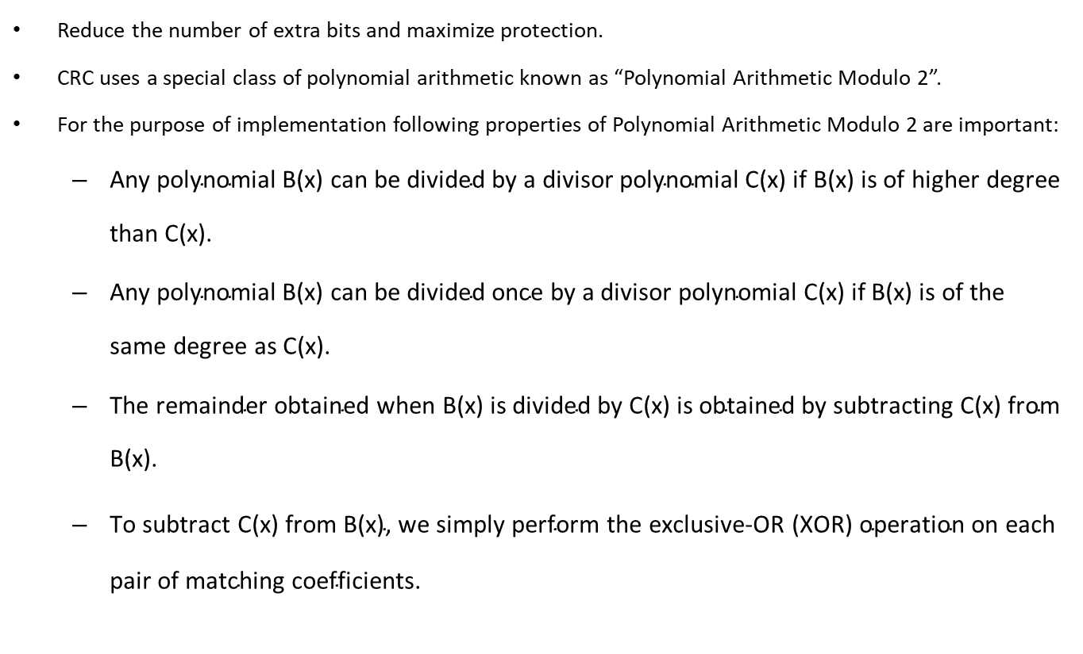
Cycle Redundancy Check (CRC)
Reduce the number of extra bits and maximize protection.
CRC uses a special class of polynomial arithmetic known as “Polynomial Arithmetic Modulo 2”.
For the purpose of implementation following properties of Polynomial Arithmetic Modulo 2 are important:
$\text{Any} \text{polynomial} \text{B}\text{(}\text{x}\text{) }\text{can} \text{be} \text{divided} \text{by} \text{a} \text{divisor} \text{polynomial} \text{C}\text{(}\text{x}\text{) }\text{if} \text{B}\text{(}\text{x}\text{) }\text{is} \text{of} \text{higher} \text{degree} \text{than} \text{C}\text{(}\text{x}\text{).}$
$\text{Any} \text{polynomial} \text{B}\text{(}\text{x}\text{) }\text{can} \text{be} \text{divided} \text{once} \text{by} \text{a} \text{divisor} \text{polynomial} \text{C}\text{(}\text{x}\text{) }\text{if} \text{B}\text{(}\text{x}\text{) }\text{is} \text{of} \text{the} \text{same} \text{degree} \text{as} \text{C}\text{(}\text{x}\text{).}$
$\text{The} \text{remainder} \text{obtained} \text{when} \text{B}\text{(}\text{x}\text{) }\text{is} \text{divided} \text{by} \text{C}\text{(}\text{x}\text{) }\text{is} \text{obtained} \text{by} \text{subtracting} \text{C}\text{(}\text{x}\text{) }\text{from} \text{B}\text{(}\text{x}\text{).}$
$\text{To} \text{subtract} \text{C}\text{(}\text{x}\text{) }\text{from} \text{B}\text{(}\text{x}\text{), }\text{we} \text{simply} \text{perform} \text{the} \text{exclusive}\text{−}\text{OR}\text{ (}\text{XOR}\text{) }\text{operation} \text{on} \text{each} \text{pair} \text{of} \text{matching} \text{coefficients}\text{.}$

Slide 38

Cycle Redundancy Check (CRC)
$Given a bit string 110001 we can associate a polynomial on a single variable x for it.$
$$1.x5+1.x4+0.x3+0.x2+0.x1+1.x0 = x5+x4+1 and the degree is 5.$$
$$A k−bit frame has a maximum degree of k−1.$$
$Let M(x) be a message polynomial and C(x) be a generator polynomial.$

Slide 39
Cycle Redundancy Check (CRC)
Sender’s Algorithm:
Let r be the degree of code polynomial can call it c(x) (Both sender and receiver know it)
Append r zero bits at the end of message bits and call it S(x).
Divide S(x) by C(x) using modulo 2 division to get the remainder R(x).
Subtract R(x) from S(x) and call it T(x).
Transmit T(x).

Slide 40
Cycle Redundancy Check (CRC)
Receiver’s Algorithm:
Let receiver receive a message and call it M(x).
Divide M(x) by C(x) to get remainder R(x).
If R(x) = 0 then accept else discard.

Slide 41

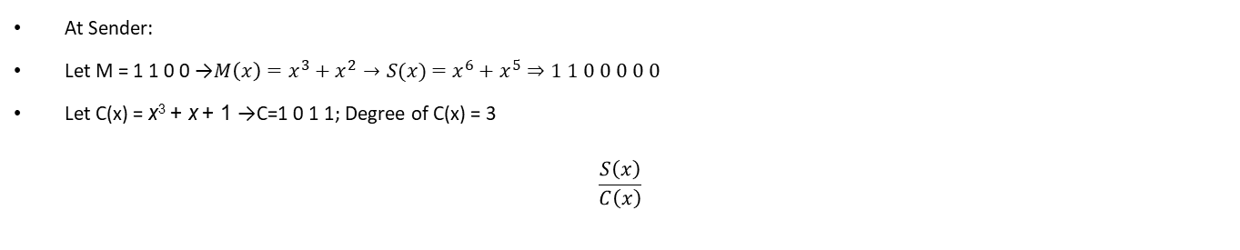
Example (Sender Side)
At Sender:
Let M = 1 1 0 0 →$M\left(x\right)=x^{3}+x^{2}→S(x)$ $=x^{6}+x^{5}⇒1 1 0 0 0 0 0$
Let C(x) = x³ + x + 1 →C=1 0 1 1; Degree of C(x) = 3
$$\frac{S\left(x\right)}{C\left(x\right)}$$
x³ + x² + x
= q(x) quotient
Division:
x³ + x + 1 ) x⁶ + x⁵
x⁶ + x⁴ + x³
dividend
divisor
x⁵ + x⁴ + x³
3
x⁵ + x³ + x²
35 ) 122
x⁴ + x²
105
x⁴ + x² + x
17
x
= r(x) remainder = 010
$$T\left(x\right)=S\left(x\right)−R\left(x\right)⇒1 1 0 0 0 1 0$$

Slide 42
Example (Receiver Side)
At receiver suppose M(x) = 1 1 0 0 0 0 0
C(x) = 1 0 1 1
R(x) = 100
=> error in the data received therefore, discard the frame.

Slide 43
CRC Properties
Properties of Generator Polynomial
Let P(x) represent what the sender sent and P(x) + E(x) is the received string. A 1 in E(x) represents that in the corresponding position in P(x) the message the bit is flipped.
We know that P(x)/C(x) leaves a remainder of 0, but if E(x)/C(x) leaves a remainder of 0, then either E(x) = 0 or C(x) is factor of E(x).
When C(x) is a factor of E(x) we have problem; errors go unnoticed.
If there is a single bit error then E(x) = x^{i}, where i determines the bit in error. If C(x) contains two or more terms it will never divide E(x), so all single bit errors will be detected.
Therefore it is important to use code polynomial which satisfy the above properties and maximize the error detection power.

Slide 44
Standard Polynomials used for CRC
Six generator polynomials that have become international standards are:
CRC-8 = x⁸+x²+x+1
CRC-10 = x¹⁰+x⁹+x⁵+x⁴+x+1
CRC-12 = x¹²+x¹¹+x³+x²+x+1
CRC-16 = x¹⁶+x¹⁵+x²+1
CRC-CCITT = x¹⁶+x¹²+x⁵+1
CRC-32 = x³²+x²⁶+x²³+x²²+x¹⁶+x¹²+x¹¹+x¹⁰+x⁸+x⁷+x⁵+x⁴+x²+x+1

Slide 45
CRC Properties
In general, it is possible to prove that the following types of errors can be detected by a C(x) with the stated properties:
All single-bit errors, as long as the x^{k} and x⁰ terms have nonzero coefficients.
All double-bit errors, as long as C(x) has a factor with at least three terms.
Any odd number of errors, as long as C(x) contains the factor (x+1).
Any “burst” error (i.e., sequence of consecutive error bits) for which the length of the burst is less than k bits. (Most burst errors of larger than k bits can also be detected.)

Slide 46
Error Correction Technique
Also known as forward error correction (FEC).
FEC is used in transmission of radio signals, such as those used in transmission of digital television (Reed-Solomon and Trellis encoding) and 4D-PAM5 (Viterbi and Trellis encoding).
Some FEC is based on Hamming Codes

Slide 47
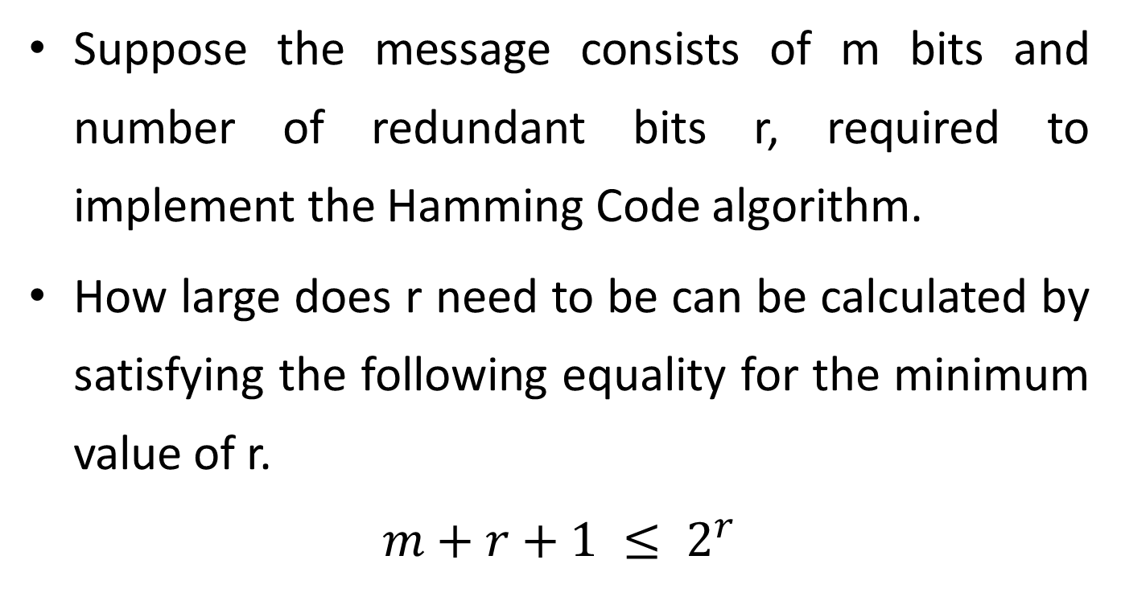
Hamming Codes (for 1 bit error correction)
Suppose the message consists of m bits and number of redundant bits r, required to implement the Hamming Code algorithm.
How large does r need to be can be calculated by satisfying the following equality for the minimum value of r.
$$m+r+1 ≤ 2^{r}$$

Slide 48
Sender’s Algorithm
Bits are numbered from left to right from 1 to m+r.
Power of 2 bit positions are reserved for redundant bits.
Remaining bit position are filled with message bits.
Each redundant bit will force a parity (even or odd) on the subset of message bits.

Slide 49
Sender’s Algorithm
Each data bit is included in a unique set of parity bits, as determined its bit position in binary form. a. Parity bit 1 covers all the bits positions whose binary representation includes a 1 in the least significant position (1, 3, 5, 7, 9, 11, etc). b. Parity bit 2 covers all the bits positions whose binary representation includes a 1 in the second position from the least significant bit (2, 3, 6, 7, 10, 11, etc). c. Parity bit 4 covers all the bits positions whose binary representation includes a 1 in the third position from the least significant bit (4–7, 12–15, 20–23, etc).

Slide 50
Sender’s Algorithm
d. Parity bit 8 covers all the bits positions whose binary representation includes a 1 in the fourth position from the least significant bit bits (8–15, 24–31, 40–47, etc). e. In general, each parity bit covers all bits where the bitwise AND of the parity position and the bit position is non-zero.
Since we check for even parity set a parity bit to 1 if the total number of ones in the positions it checks is odd.
Set a parity bit to 0 if the total number of ones in the positions it checks is even.

Slide 51
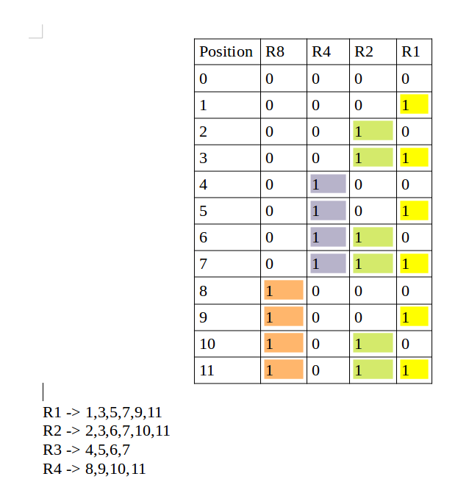
Determination of Subset

Slide 52
Example
m=1011
r=3
m+r = 7
 |  | 1 |  | 0 | 1 | 1
r1 | r2 | d1 | r3 | d2 | d3 | d4
1 | 2 | 3 | 4 | 5 | 6 | 7

Slide 53
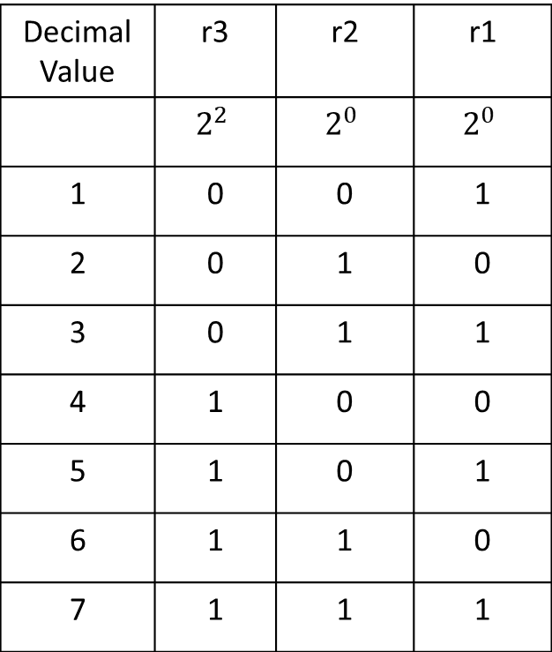
Subset of r1= 1, 3, 5, 7 Subset of r2 = 2, 3, 6, 7 Subset of r3 = 4, 5, 6, 7
Decimal Value | r3 | r2 | r1
 | $$2^{2}$$ | $$2^{0}$$ | $$2^{0}$$
1 | 0 | 0 | 1
2 | 0 | 1 | 0
3 | 0 | 1 | 1
4 | 1 | 0 | 0
5 | 1 | 0 | 1
6 | 1 | 1 | 0
7 | 1 | 1 | 1

Slide 54
Example
For implementing odd parity
r1 = 1
r2= 0
r3= 1
T(x) = 1 0 1 1 0 1 1

Slide 55
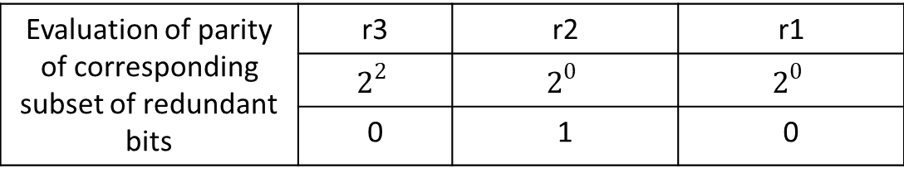
Receiver’s Algorithm
If the parity is satisfied on the subsets then fill 1 in the table otherwise 0. The decimal equivalent of that binary value will give the position of error.
For example suppose the received message =1 0 1 1 0 0 1
0 1 0 => 2 is the position of error.
Evaluation of parity of corresponding subset of redundant bits | r3 | r2 | r1
 | $$2^{2}$$ | $$2^{0}$$ | $$2^{0}$$
 | 0 | 1 | 0

